Slide 1
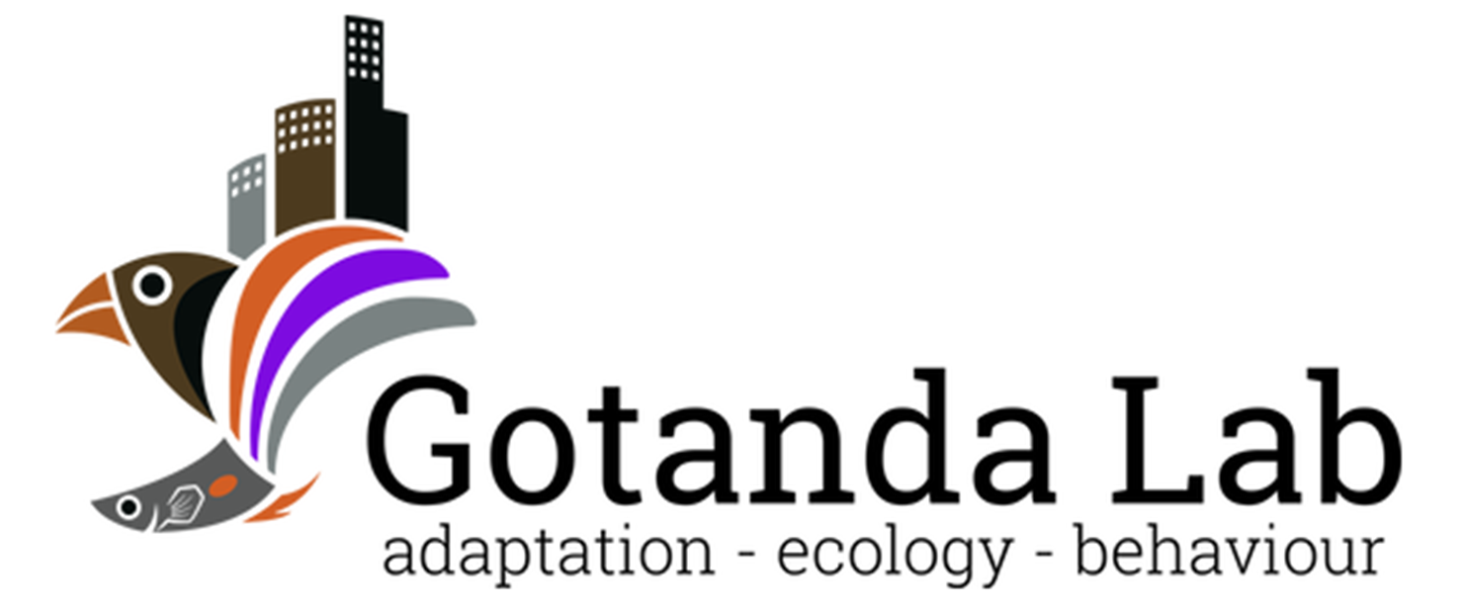

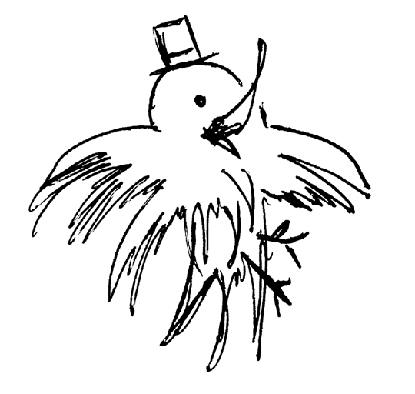
Sentinel behaviour in mammal and avian species
Alex Popescu, Dr. Kiyoko M. Gotanda
Department of Biological Sciences, Brock University
OE3C 2024

Slide 2




Sentinel behaviour
A form of coordinated vigilance:
- Individuals take turns being vigilant over other group members.
- Can result in increased safety and foraging efficiency in foragers.
- Sentinel loses foraging opportunities.
Lost foraging opportunity
Why do sentinels perform the behaviour if it is costly?
↑ Foraging efficiency
↓ Predation risk

Slide 3

Selfless or selfish?
Sentinel behaviour was originally thought to be a selfless behaviour.
↑ Foraging efficiency
↓ Predation risk
Lost foraging opportunity
Sentinel
Forage
Costs of sentinel behaviour compensated by the actions of other sentinels.

Slide 4





Selfless or selfish?
More recently, empirical studies support the selfish, state-dependent model for sentinel behaviour.
Sentinel present
Sentinel Absent
Decision to perform sentinel behaviour dependent on individual’s energetic state & need for safety.
Lost foraging opportunity
↑ Risk
Earlier threat detection

Slide 5
Decisions, decisions…
The decision to perform sentinel behaviour could therefore be affected by factors both intrinsic and extrinsic.
Sentinel present
Sentinel Absent
Understanding the effects and interactions between these factors can provide insights into the decision-making of similar behaviours.
Lost foraging opportunity
↑ Risk
Earlier threat detection

Slide 6
Objectives
Our objective was to identify and analyze the factors involved in the decision to perform sentinel behaviour.
To do so, we performed a scoping review and searched Web of Science for empirical studies on sentinel decision-making.

Slide 7
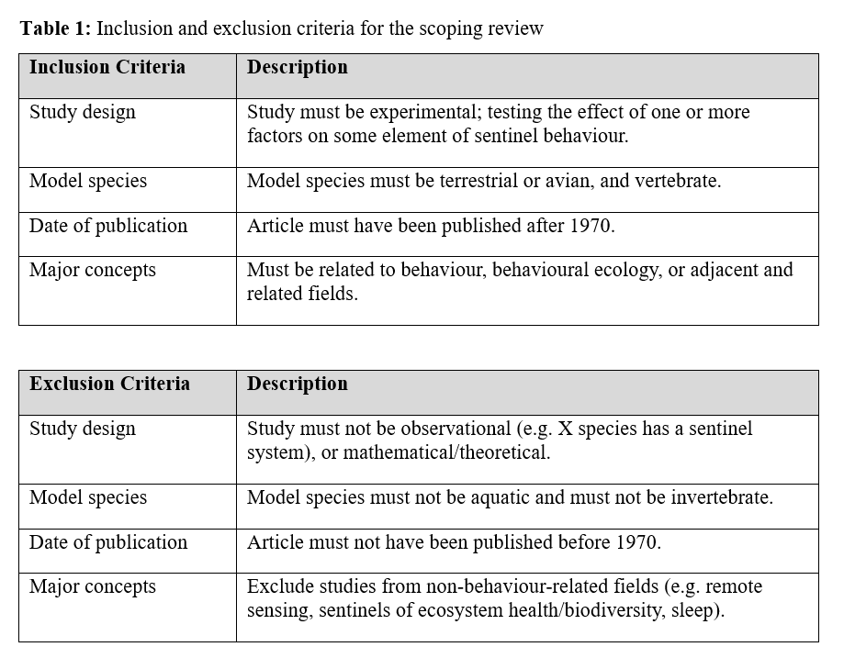
Methods
We searched Web of Sciences on Nov. 1st, 2022
- “Sentinel AND Behavio*” as keywords
- Filtered by major concepts

Slide 8
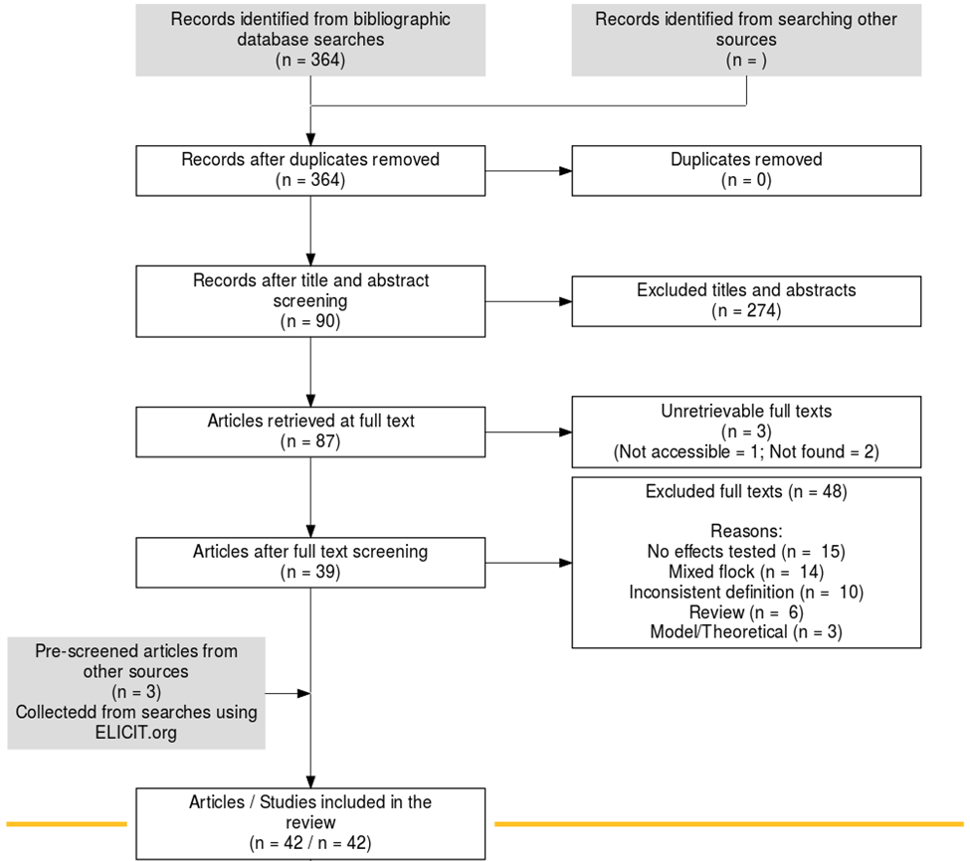
Search Results
Search string returned 364 records.
After screening, we retained 42 studies that fit our inclusion criteria.

Slide 9
Trends observed
The effects of several intrinsic and extrinsic factors were common in both mammal and avian species, including:
Intrinsic factors such as sex, body mass, and satiation
Extrinsic factors such as dominance, group size, and risk
Many intrinsic and extrinsic factors are energy-related.
An interaction between sex and dominance was often reported.
Notes:
Talk more about the implications of intrinsic and extrinsic factors

Slide 10






Energy-related factors
Sex: >
Body mass: >
Satiation: >
Group size: <
Sentinel present
Sentinel Absent
Lost foraging opportunity
↑ Risk
Earlier threat detection
Notes:
Use figures from literature to prove point

Slide 11
Risk
The greater the risk, the greater the incentive to be a sentinel.
e.g. The presence of young or of predators results in increased sentinel efforts from adult individuals.
Sentinel present
Sentinel Absent
Lost foraging opportunity
↑ Risk
Earlier threat detection
Surprisingly, the presence of outgroup rivals also increased sentinel efforts…
Notes:
Use figures from literature to prove point

Slide 12

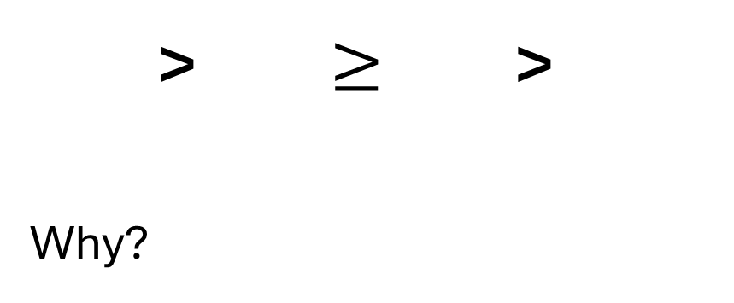
Dominance
Sentinel present
> $≥$ >
Why?
Sentinel Absent
Lost foraging opportunity
Could be energy-related but be a result of different benefits provided by the behaviour.
↑ Risk
Earlier threat detection
Notes:
Use figures from literature to prove point

Slide 13
Non-antipredator benefits
The sentinel’s perch provides good visibility over a large area.
This could provide non-antipredator benefits to certain individuals:
Territory defense
Mate guarding
Sentinel present
Sentinel Absent
Lost foraging opportunity
↑ Risk
Earlier threat detection
Notes:
Use figures from literature to prove point

Slide 14
Conclusions
Both intrinsic and extrinsic factors could have great effects on sentinel decision-making:
Energetic availability ↑ = ↑ Sentinel behaviour
Risk ↑ = ↑ Sentinel behaviour
Habitat can affect these factors, in turn affecting sentinel behaviour (e.g. Urban vs Natural environments).
Moreover, individuals could have additional uses for sentinel behaviour.
Notes:
What research remains to be done? Need to take a holistic approach as intrinsic and extrinsic factors can interact

Slide 15
Conclusions
More research is needed to fully understand how sentinel decision-making is affected by internal and external motivators.
Future studies could focus on:
Interactions between factors
Non-antipredator benefits
- Anthropogenic factors on sentinel behaviour

Slide 16

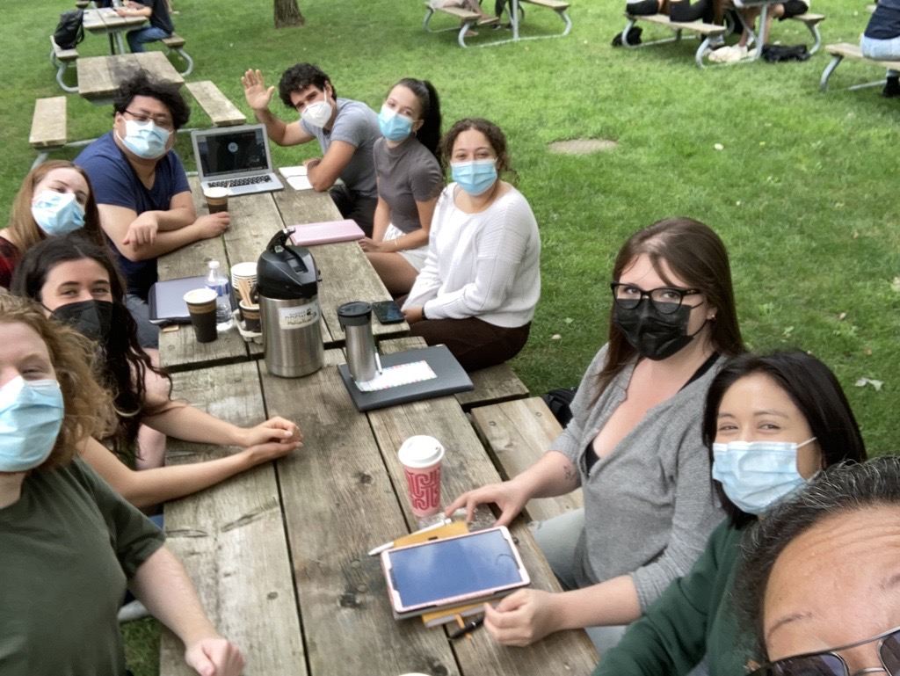

Aknowledgements
My supervisors: Dr. Kiyoko Gotanda, Dr. Liette Vasseur, Dr. Anne Clark
The Gotanda Lab
My family and friends

Slide 17
Questions?

